Slide 1







Lodz, 21st November 2017
Vratsa (Bulgaria)
Universidad de
Valladolid (España)
Tesalia (Grecia)
Zejtun (Malta)
Idalion (Chipre)
Molise (Italia)
Lodz (Polonia)

Slide 2



WHAT IS THE RURAL DEAR AGENDA ?
A tool, an instrument and guidelines to:
Develop and promote a participatory model of DEAR for European rural municipalities, with inclusive, innovative and effective strategies and action lines.
GENERAL OBJECTIVE
Project funded by European Commission

Slide 3

THE RURAL DEAR AGENDA
&
THE LOCAL AGENDAS
MODEL
General Guidelines, adaptable to any EU rural area
LOCAL
Local adaptations of the Model to a concrete rural contexts.
Project funded by European Commission

Slide 4
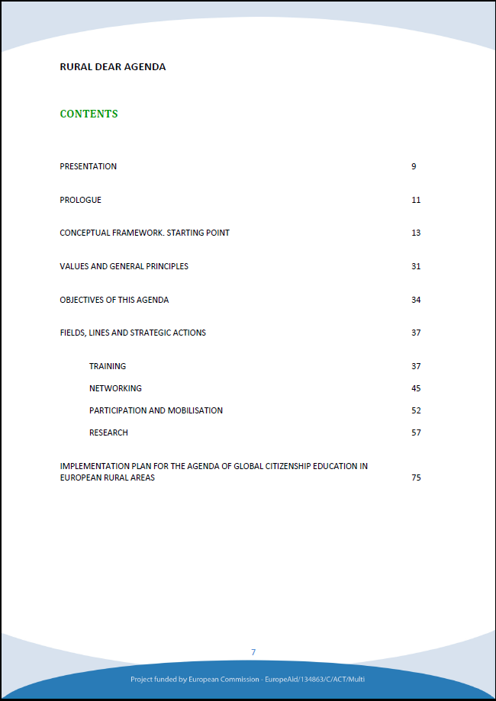
CONTENTS & STRUCTURE
Introductory chapters
Part 1: Framework
Part 2: Action lines
Part 3: General implementation plan
Project funded by European Commission

Slide 5
CONCEPTUAL FRAMEWORK
Education for global citizenship
  Feeling of belonging to one common reality and humanity.
  Political, economical, social and cultural global interdependency.
  Interconexion between local, national and global levels.
Rural
  Dinamic area.
  Own characteristics and features (different from urban)
  Area “being re-built”.
Project funded by European Commission

Slide 6
CONCEPTUAL FRAMEWORK
POPULAR EDUCATION
General educative approach: knowledge from the grassroots.
GENERAL PRINCIPLES & VALUES
GLOBAL CITIZENSHIP EDUCATION
“Glocal scope”
Awareness of global consequences of local actions
Multidimensional people & learning
Values, knowledges, attitudes and acts
Politic and ecosistemic Visión
People owners of rights and being part of a shared ecosistem.
Project funded by European Commission

Slide 7
CONCEPTUAL FRAMEWORK
METHODOLOGY PRINCIPLES
1 | Mix practice and theory
2 | “Learning by doing”
3 | From concret to general/ global
4 | Start from people needs and interests
5 | Educative communitities
Project funded by European Commission

Slide 8
OPPERATIVE OBJECTIVES ACTION LINES
S.O.1. Improve educative actions…
Undertake training process with agents on GCE approach
Promote the design and implementation taylored/originated by/to rural areas
Promote networking, coordination and complementarity between GCG agents.
Analyse GCE actions’ impact to generate new proposals
TRAINING
NETWORKING & COORDINATION
PARTICIPATION & MOBILISATION
RESEARCH
TRAINING
Promote participation of people and CSOs in GCE
Promote positive attitudes towards peace, justice, HRs…..
S.O.2. Contribute
to change social attitudes…
Project funded by European Commission

Slide 9
TRAINING
Strategic Actions
TRAINING
Training courses for educational agents in formal and non-formal settings
Seminars on GCE for various agentes involved in education
Annual seminars to exchange experiences
Setting up of a virtual bank of resources, materials, programmes and significant actors.
Training courses for non-formal educational social agents (topics, methods , collaborative work)
Continous advice and support during the design and implementation phase
Project funded by European Commission

Slide 10
NETWORKING & COORDINATION
Strategic Actions
NETWORKING & COORD.
Creation of a space for local coordination
Join workplans and interventions
Creation of a network of Local Authorities for GCE
Project funded by European Commission

Slide 11
PARTICIPATION & MOBILISATION
Strategic Actions
PARTICIPATION & MOBILISATION
Community revitalisation and support to new movements and social organisations.
Support for the design and implementation of GCE actions by local groups.
Promotion of opportunities and spaces for debate and exchange
Organisational strethening of local social groups
Project funded by European Commission

Slide 12
RESEARCH & EVALUATION
Strategic Actions
PARTICIPATORY RESEARCH
Participatory diagnosis.
Systematisation of the experiences
EVALUATION OF THE AGENDA
Participatory follow up of actions
Design of evaluation plan and indicators
Monitoring
Gathering and analysing data
Evaluation report
Project funded by European Commission

Slide 13
IMPLEMENTATION - Organisation chart

Slide 14
TIPS TO START
Identify actors and establish the coordination team: promoter entity and local NGOs; L.As; educative centers, CSOs, etc.
Coordinator team start working in the implementation plan of the agenda at local level:
    Implementation chart as baseline/guide
    Adapting to local reality: actors, enviroment, times, needs, interests, etc.
Identify and count on a support team to help in the process.
Contacting and creating local teams to start actions in the field.

Slide 15

Thanks a lot!
María Carracedo
Esther Domenech
Luis Pérez
 observatorio.cooperacion@uva.es
www.ruraldearagenda.eu

