Slide 1







The situation of
Education for Development in European Rural Areas
Lodz, 2017/ Lodz, 2017
Vratsa (Bulgaria)
Zejtun (Malta)
Tesalia (Grecia)
Idalion (Chipre)
Lodz (Polonia)
Molise (Italia)
Ignacio Aranda | ignacio.aranda@dip_valladolid.es
María Carracedo Bustamante | maria.carracedo@cooperacion.uva.es
Roberto MonjasAguado | rmonjas@mpc.uva.es

Slide 2


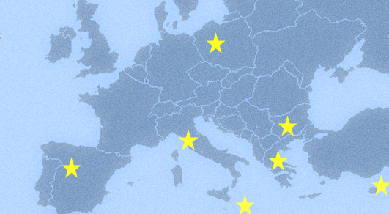

EU Project RURAL DEAR AGENDA - EYD2015
EuropeAid. 2015-2017. (DEAR – Local Authorities)
University of Social Sciences, Spolecza, Lodz
Trade and Industry Chambre, Vratsa.
Diputación Provincial Valladolid (leader)
&
Observatorio Cooperación Internacional – Uva (research leader)
Regional Authority Molise
University of Thessaly,Volos
Municipality of Idalion
Foundation for Social Inclusion, FOPSIM
www.ruraldearagenda.eu
Project funded by European Commission

Slide 3
WORFLOW & STAGES
1. Diagnosis Stage
2. Experimental
Stage
3. Design Stage
Research and data collection in every country
Common Diagnosis Report
Pilot projects in every country
Model and Local Agendas
2015
2016
2017

Slide 4

Diagnosis Stage
METHODOLOGY I
AIM
Obtaining a clear diagnosis of the state of DEAR in European rural areas to design effective strategies
Global Analysis of DE situation rural EU areas
Local Diagnosis
Local Diagnosis
Local Diagnosis
Local Diagnosis
Local Diagnosis
Local Diagnosis
Local Diagnosis
Project funded by European Commission

Slide 5
Diagnosis Stage
METHODOLOGY II
Public Opinion
Formal education
Informal education
Non Formal education
  Public opinion on DE related issues – Pool (3026 people from the 7 EU rural areas,)
  Non-formal education influence by DE activities performed by NGO
  Formal education influence: presence of development issues on primary and high schools curricula
  Informal education influence: Treatment of development issues in local press
+ State of the art of DEAR in each territory.
+ Qualitative and participatory input from Panel of experts & Working groups

Slide 6
MAIN RESULTS I
Diagnosis Stage
PERCEPTION OF RURAL CONTEXTS.
In disadvantage
Loss of people
Scarcity
Ageing population
Depopulation
Limitation
Lack of opportunities
Shortage of resources
Worse conditions than urban areas
Rural areas description in every partner country talks about handicaps.
This constitutes one of the reasons that limit the action.
“The urban social model has emptied the rural areas, both qualitative and quantitative, there is no critical mass to reverse the process” (WG)

Slide 7
MAIN RESULTS II
Diagnosis Stage
PEOPLE’S WORRIES
People worries about:
Wars and military conflicts.
Economic crisis and unemployment.
Problems with less relevance:
Limited access to sanitation
Limited access to safe drinking water.
People just worry about what can affect directly to their daily lives.
Project funded by European Commission

Slide 8
MAIN RESULTS III
Diagnosis Stage
OPINION ON GLOBAL POVERTY CAUSES
Corruption, War and political instability are considered the main causes of poverty.
On the contrary labor standards and the policy of transnational companies are identified as causes only by a minority.
Project funded by European Commission

Slide 9
MAIN RESULTS IV
Diagnosis Stage
PEOPLE’S ATTITUDES.
Rural people consider that structural, political and cultural changes are needed...
Almost the half (59%)of the people thinks that their actions do not contribute to improve the world and to change unfair situations.
24% does not know how to contribute
As a citizen do you consider that your actions can contribute to change the situation of impoverished countries?
SO
The level of participation as active citizens is very low and/or just limited to punctual moments (usually donations)

Slide 10


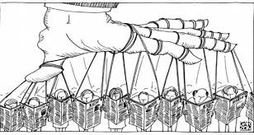
MAIN RESULTS V
Diagnosis Stage
MASS MEDIA INFLUENCE
Mass media are the main source of information in rural areas: TV and papers
Mass media show a desarrollist/caritative vision of global inequalities without any analysis of causes.
Topics as human rights, gender, environment…. never are front page.
Lack of infographies on those pieces.
Do not promote interest nor critical thinking.
www.ruraldearagenda.eu

Slide 11
MAIN RESULTS VII
Diagnosis Stage
STATE OF THE ARTS OF DEVELOPMENT EDUCATION
DEAR as instrument to promote social justice and human rights is little known in rural areas.
Lack of economical support for DEAR.
Lack of trained staff in LAs, educative centers, etc.
Depends on the personal willing and interest of teachers, staff…
Grassroot innitiave, mostly performed by women
Organised by or in collaboration with NGOs.
Not tailored to the rural contexts.
Punctual and disconnected actions difficult the understanding and the anlysis.
Not included in curricula, and there are no educative guidelines.
Lack of evaluation of those actions
“There are no policies promoting
Education for Development, and when they exist they do not get into effect” (from WG)

Slide 12
Lack of commitment and economical support of DE issues from authorities
DEAR do not respond to specific rural contexts and population.
General unknowledge (and thus lack of interest) on global development/ citizenship issues. Need of trained and informed key agents
CHALLENGES
Mass media do not move to critical thinking and active participation, other sources of information shall be promoted.
The features of rural areas: little population, proximity to nature, etc.
The general opinion that changes are needed and the half of population willing to contribute.
Grass root innitiative.
DEAR, being an educative and participative process can contribute to rural social and economic development.
OPPORTUNITIES

Slide 13
KEY LINES OF ACTION
Capacity building of agents
Promotion of grassroot participation
Fostering Networking of agents and organizations

Slide 14

THANK YOU VERY MUCH!!
Dziękuję bardzo !!
¡Muchas gracias!
Ignacio Aranda
María Carracedo Bustamante
Roberto monjas
 observatorio.cooperacion@uva.es
www.ruraldearagenda.eu

